Slide 1

Department of Mechanical Engineering
Unit – 6: -
Numerical Methods
Subject name : Engineering Physics
Faculty name:
Dhaiwat Trivedi

Slide 2
Introduction
The main goal of numerical analysis is to develop efficient algorithms for computing precise numerical values of mathematical quantities, including functions, integrals, solutions of algebraic equations, solutions of differential equations, etc. Often the numerical data and the methods used are approximate ones. Hence, the error in a computed result may be caused by the errors in the data, or the errors in the method, or both. In any numerical computation, there are four key sources of errors:
Inexactness of mathematical model for the underlying physical
phenomenon
(ii) Errors in measurements of parameters entering the model
(iii) Round-off errors in computer arithmetic
(iv) Approximations used to solve the mathematical systems

Slide 3
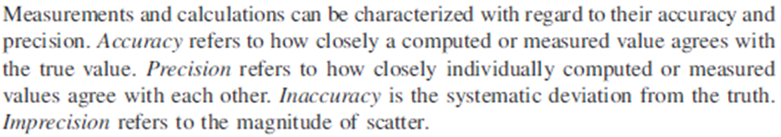
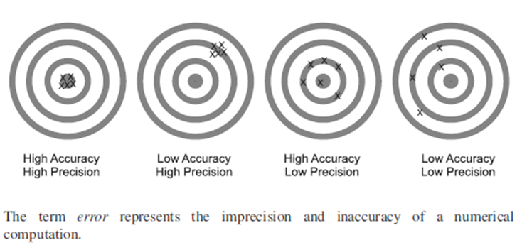
Accuracy and Precision

Slide 4
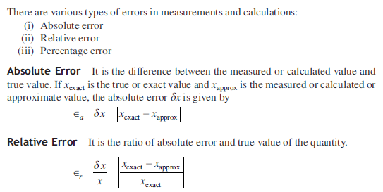
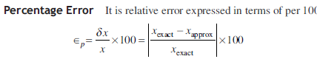
Types of Errors

Slide 5
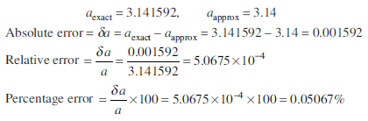
Example 1
Ex. of Types of Errors
Solution

Slide 6
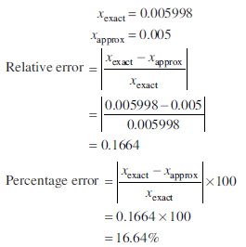
Ex. of Types of Errors
Example 2
Solution

Slide 7
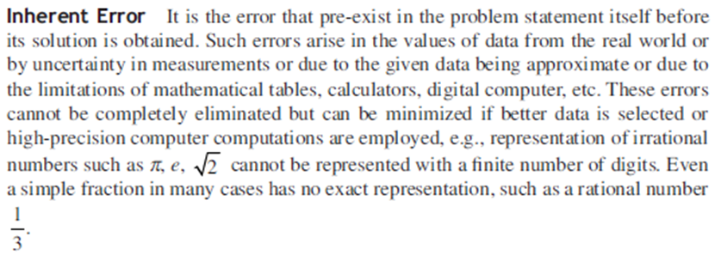
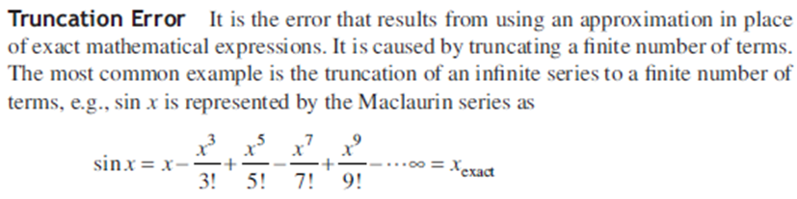
Sources of Errors

Slide 8
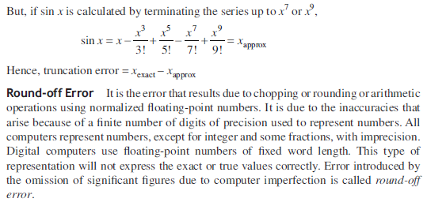
Sources of Errors

Slide 9
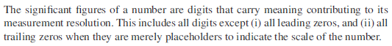
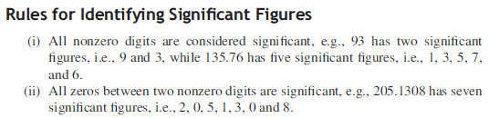
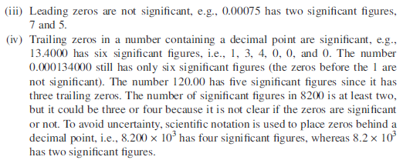
Significant Figures

Slide 10
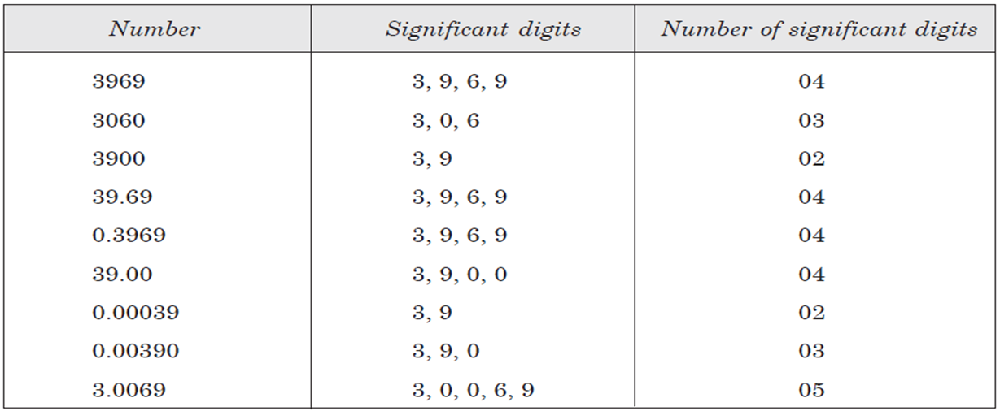

Slide 11
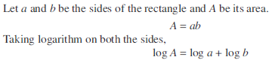
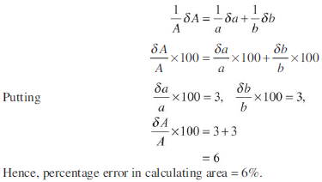
Example - 3
Solution

Slide 12
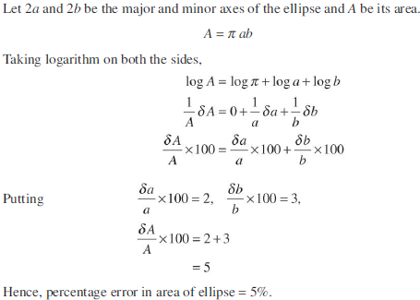
Example - 4
Solution

Slide 13
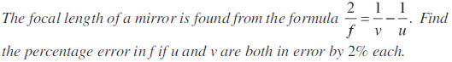
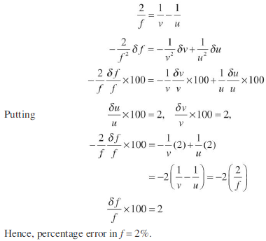
Example - 5
Solution

Slide 14
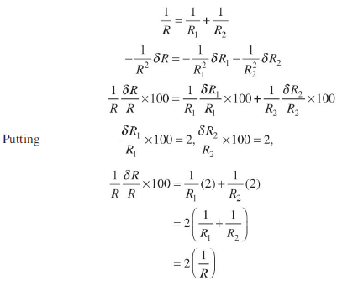
Example - 6
Solution

Slide 15
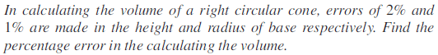
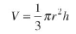
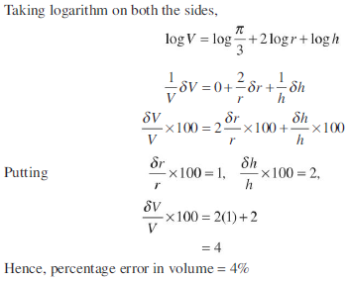
Example - 7
Solution
Let r and h be the radius of base and height of the right circular cone and V be its volume.

Slide 16
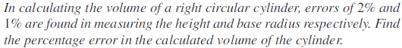
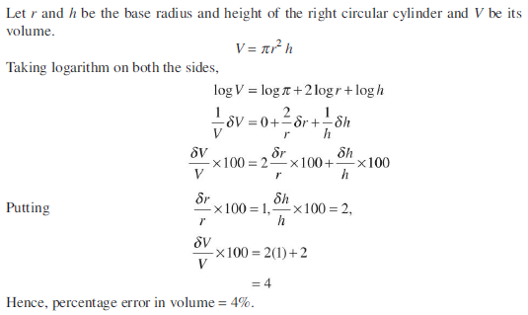
Example - 8
Solution

Slide 17
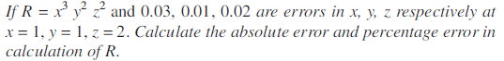
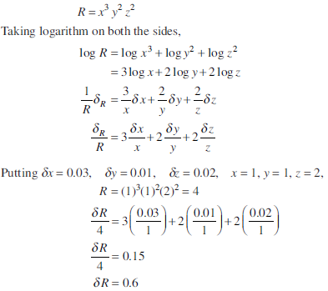
Example - 9
Solution

Slide 18
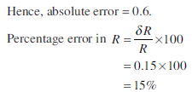
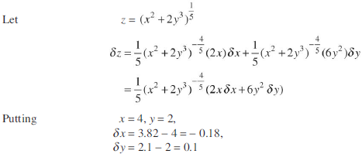
Examples
Example 10
Solution

Slide 19
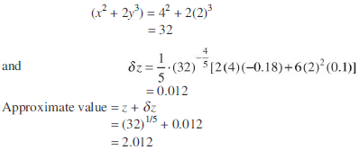
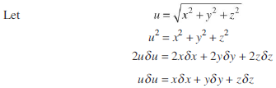
Examples
Example 11
Solution

Slide 20
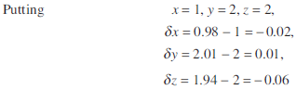
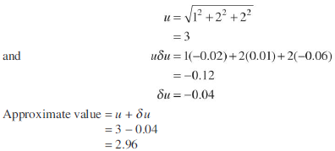
Example - 11

Slide 21
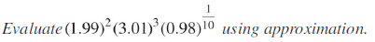
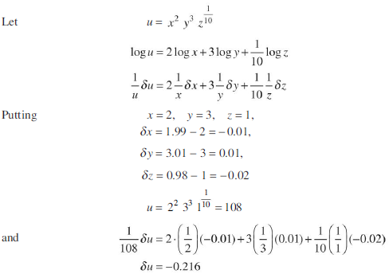
Example - 12
Solution

Slide 22
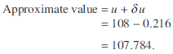
Example - 12

Slide 23
Department of Mechanical Engineering
Unit – 6: -
Numerical Methods
Subject name : Engineering Physics
Faculty name:
Dhaiwat Trivedi

Slide 24
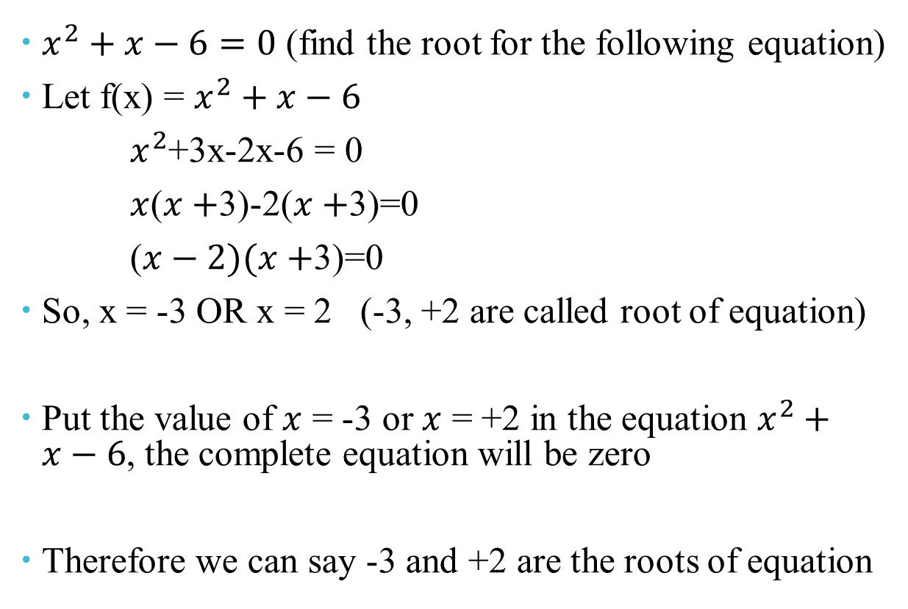
Solution of Nonlinear Equations
$x^{2}+x−6=0$ (find the root for the following equation)
Let f(x) = $x^{2}+x−6$
$x^{2}$+3x-2x-6 = 0
$x$($x+$3)-2($x+$3)=0
($x−2)(x+$3)=0
So, x = -3 OR x = 2 (-3, +2 are called root of equation)
Put the value of $x$ = -3 or $x$ = +2 in the equation $x^{2}+x−6$, the complete equation will be zero
Therefore we can say -3 and +2 are the roots of equation

Slide 25
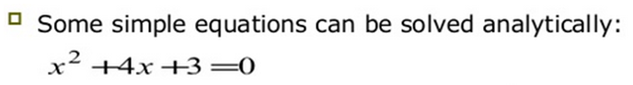
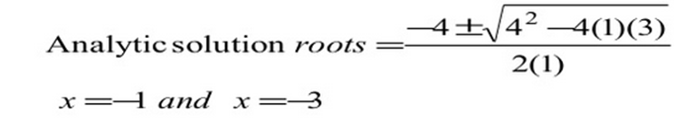
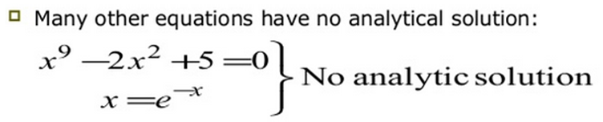
Solution of Nonlinear Equations

Slide 26
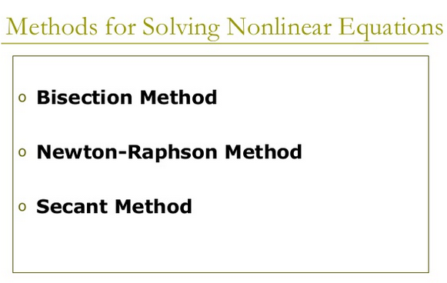
Methods for Solving Nonlinear Equations

Slide 27
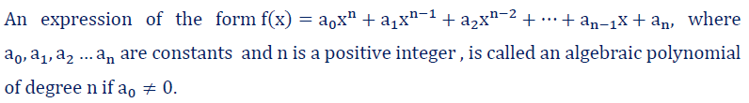
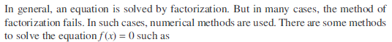
Approximate solutions of nonlinear equations
Algebraic Polynomials:
Transcendental Equations

Slide 28
Numerical Methods to find Roots of Algebraic
Roots of Algebraic and Transcendental Equations :
Bisection Method
False position Method(Regula-Falsi Method)
Secant method
Newton-Raphson Method

Slide 29
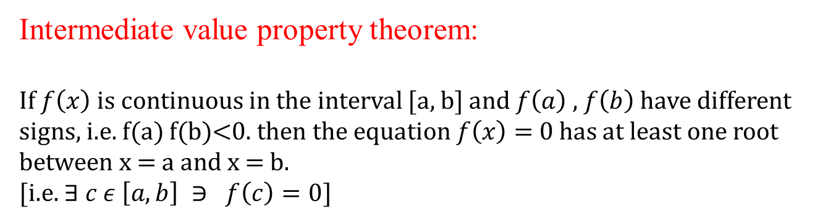
Intermediate value property theorem
Intermediate value property theorem:
If $f\left(x\right)$ is continuous in the interval [a, b] and $f\left(a\right)$ , $f\left(b\right)$ have different signs, i.e. f(a) f(b)<0. then the equation $f\left(x\right)=$0 has at least one root between x = a and x = b.
[i.e. $∃ c ε \left[a, b\right] ∋ f\left(c\right)=0$]
There Exist
Such That

Slide 30
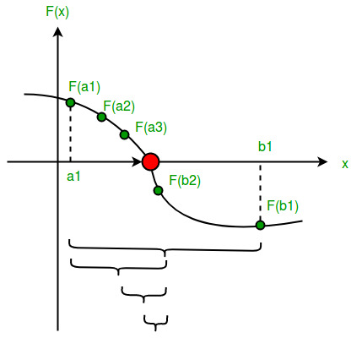
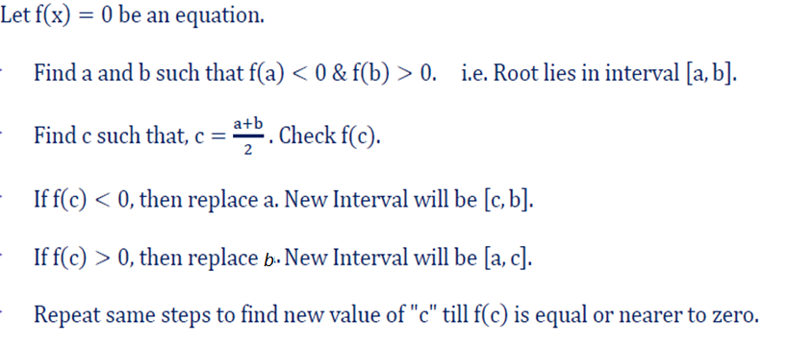
Bisection Method:
Working Rule

Slide 31
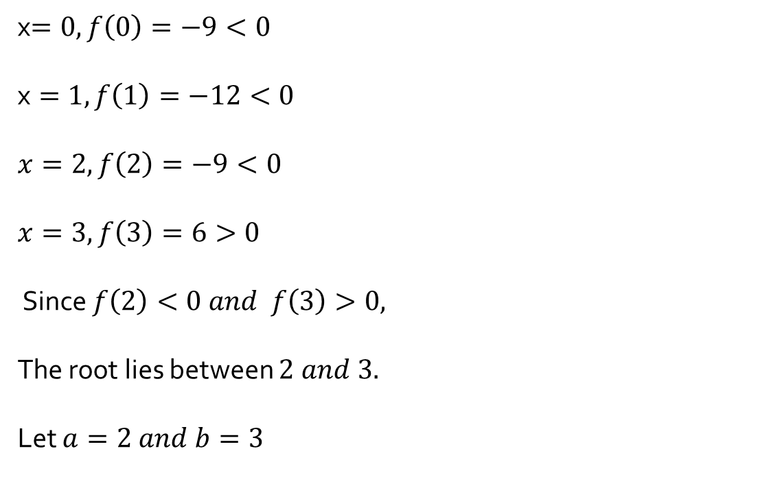

Example 1
Find the root of the equation $x^{3}−4x−9=0$,using the bisection method in four stages, correct up to three decimal places.
Bisection Method (Bolzano Method)
Solution
x$=0,f\left(0\right)=−9<0$
$$\text{x}=1, f\left(1\right)=−12<0$$
$$x=2, f\left(2\right)=−9<0$$
$$x=3, f\left(3\right)=6>0$$
Since $f\left(2\right)<0 and f\left(3\right)>0,$
The root lies between $2 and 3.$
Let $a=2 and b=3$

Slide 32
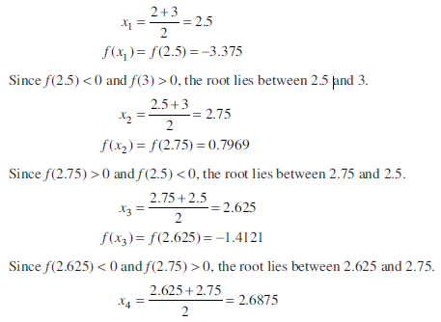
Bisection Method (Bolzano Method)

Slide 33
$$x=2, f\left(2\right)=−9<0 x=3, f\left(3\right)=6>0$$
Let $a=2$ and $b=3$
a(-Ve) | b(+Ve) | $$c=\frac{a+b}{2}$$ | f (c)=$x^{3}−4x−9=0$
2 | 3 | 2.5 | $$<0$$

Slide 34
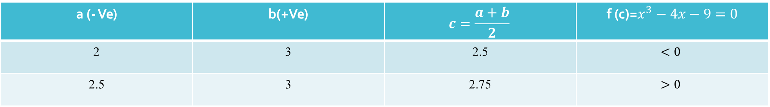
$$x=2, f\left(2\right)=−9<0 x=3, f\left(3\right)=6>0$$
Let $a=2$ and $b=3$
a (- Ve) | b(+Ve) | $$c=\frac{a+b}{2}$$ | f (c)=$x^{3}−4x−9=0$
2 | 3 | 2.5 | $$<0$$
2.5 | 3 | 2.75 | $$>0$$

Slide 35
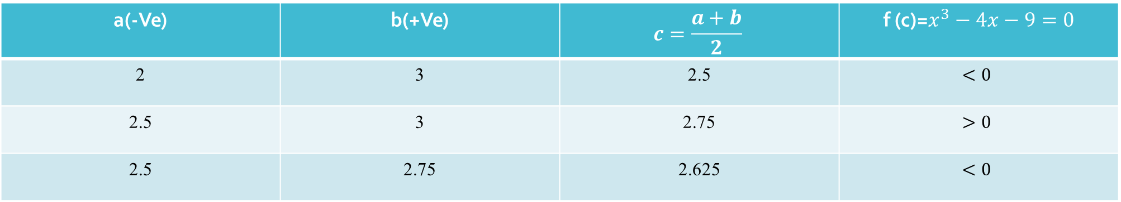
$$x=2, f\left(2\right)=−9<0 x=3, f\left(3\right)=6>0$$
Let $a=2$ and $b=3$
a(-Ve) | b(+Ve) | $$c=\frac{a+b}{2}$$ | f (c)=$x^{3}−4x−9=0$
2 | 3 | 2.5 | $$<0$$
2.5 | 3 | 2.75 | $$>0$$
2.5 | 2.75 | 2.625 | $$<0$$

Slide 36
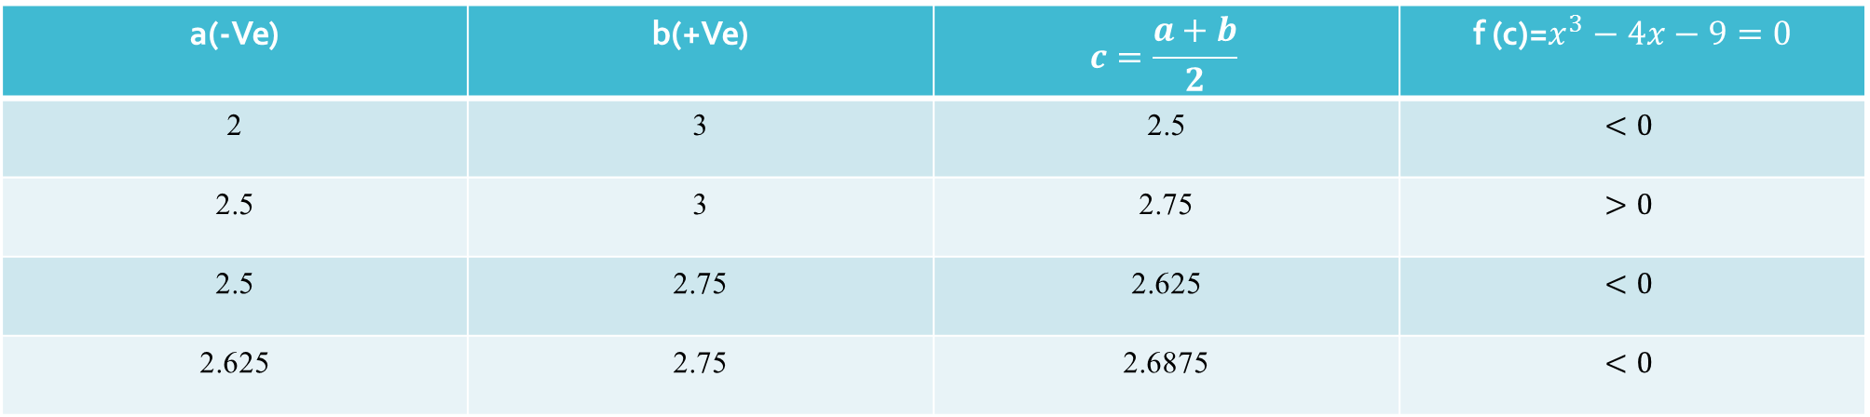
$$x=2, f\left(2\right)=−9<0 x=3, f\left(3\right)=6>0$$
Let $a=2$ and $b=3$
a(-Ve) | b(+Ve) | $$c=\frac{a+b}{2}$$ | f (c)=$x^{3}−4x−9=0$
2 | 3 | 2.5 | $$<0$$
2.5 | 3 | 2.75 | $$>0$$
2.5 | 2.75 | 2.625 | $$<0$$
2.625 | 2.75 | 2.6875 | $$<0$$
$$So, Requied root of given equation is 2.6875$$

Slide 37

Example 2
Find the root of the equation $x^{3}−4x−9=0$,using the bisection method correct up to three decimal places.
Bisection Method (Bolzano Method)
Solution
x$=0,f\left(0\right)=−9<0$
$$\text{x}=1, f\left(1\right)=−12<0$$
$$x=2, f\left(2\right)=−9<0$$
$$x=3, f\left(3\right)=6>0$$
Since $f\left(2\right)<0 and f\left(3\right)>0,$
The root lies between $2 and 3.$
Let $a=2 and b=3$

Slide 38

$$x=2, f\left(2\right)=−9<0 x=3, f\left(3\right)=6>0$$
a(-Ve) | b(+Ve) | $$c=\frac{a+b}{2}$$ | f (c)=$x^{3}−4x−9=0$
2 | 3 | 2.5 | $$<0$$

Slide 39

a(-Ve) | b(+Ve) | $$c=\frac{a+b}{2}$$ | f (c)=$x^{3}−4x−9=0$
2 | 3 | 2.5 | $$<0$$
2.5 | 3 | 2.75 | $$>0$$

Slide 40

a(-Ve) | b(+Ve) | $$c=\frac{a+b}{2}$$ | f (c)=$x^{3}−4x−9=0$
2 | 3 | 2.5 | $$<0$$
2.5 | 3 | 2.75 | $$>0$$
2.5 | 2.75 | 2.625 | $$<0$$

Slide 41

a(-Ve) | b(+Ve) | $$c=\frac{a+b}{2}$$ | f (c)=$x^{3}−4x−9=0$
2 | 3 | 2.5 | $$<0$$
2.5 | 3 | 2.75 | $$>0$$
2.5 | 2.75 | 2.625 | $$<0$$
2.625 | 2.75 | 2.6875 | $$<0$$

Slide 42

a(-Ve) | b(+Ve) | $$c=\frac{a+b}{2}$$ | f (c)=$x^{3}−4x−9=0$
2 | 3 | 2.5 | $$<0$$
2.5 | 3 | 2.75 | $$>0$$
2.5 | 2.75 | 2.625 | $$<0$$
2.625 | 2.75 | 2.6875 | $$<0$$
2.6875 | 2.75 | 2.71875 | $$>0$$

Slide 43

a(-Ve) | b(+Ve) | $$c=\frac{a+b}{2}$$ | f (c)=$x^{3}−4x−9=0$
2 | 3 | 2.5 | $$<0$$
2.5 | 3 | 2.75 | $$>0$$
2.5 | 2.75 | 2.625 | $$<0$$
2.625 | 2.75 | 2.6875 | $$<0$$
2.6875 | 2.75 | 2.71875 | $$>0$$
2.6875 | 2.71875 | 2.70313 | $$<0$$

Slide 44

a(-Ve) | b(+Ve) | $$c=\frac{a+b}{2}$$ | f (c)=$x^{3}−4x−9=0$
2 | 3 | 2.5 | $$<0$$
2.5 | 3 | 2.75 | $$>0$$
2.5 | 2.75 | 2.625 | $$<0$$
2.625 | 2.75 | 2.6875 | $$<0$$
2.6875 | 2.75 | 2.71875 | $$>0$$
2.6875 | 2.71875 | 2.70313 | $$<0$$
2.70313 | 2.75 | 2.71094 | $$<0$$

Slide 45

a(-Ve) | b(+Ve) | $$c={a+b}/2$$ | f (c)=$x^{3}−4x−9=0$
2 | 3 | 2.5 | $$<0$$
2.5 | 3 | 2.75 | $$>0$$
2.5 | 2.75 | 2.625 | $$<0$$
2.625 | 2.75 | 2.6875 | $$<0$$
2.6875 | 2.75 | 2.71875 | $$>0$$
2.6875 | 2.71875 | 2.70313 | $$<0$$
2.70313 | 2.71875 | 2.71094 | $$>0$$
2.70313 | 2.71094 | 2.70703 | $$>0$$

Slide 46

a(-Ve) | b(+Ve) | $$c=\frac{a+b}{2}$$ | f (c)=$x^{3}−4x−9=0$
2 | 3 | 2.5 | $$<0$$
2.5 | 3 | 2.75 | $$>0$$
2.5 | 2.75 | 2.625 | $$<0$$
2.625 | 2.75 | 2.6875 | $$<0$$
2.6875 | 2.75 | 2.71875 | $$>0$$
2.6875 | 2.71875 | 2.70313 | $$<0$$
2.70313 | 2.75 | 2.71094 | $$<0$$
2.70313 | 2.71094 | 2.70703 | $$>0$$
2.70313 | 2.70703 | 2.70508 | $$<0$$

Slide 47

a(-Ve) | b(+Ve) | $$c=\frac{a+b}{2}$$ | f (c)=$x^{3}−4x−9=0$
2 | 3 | 2.5 | $$<0$$
2.5 | 3 | 2.75 | $$>0$$
2.5 | 2.75 | 2.625 | $$<0$$
2.625 | 2.75 | 2.6875 | $$<0$$
2.6875 | 2.75 | 2.71875 | $$>0$$
2.6875 | 2.71875 | 2.70313 | $$<0$$
2.70313 | 2.75 | 2.71094 | $$<0$$
2.70313 | 2.71094 | 2.70703 | $$>0$$
2.70313 | 2.70703 | 2.70508 | $$<0$$
2.70508 | 2.70703 | 2.70605 | $$<0$$

Slide 48

a(-Ve) | b(+Ve) | $$c=\frac{a+b}{2}$$ | f (c)=$x^{3}−4x−9=0$
2 | 3 | 2.5 | $$<0$$
2.5 | 3 | 2.75 | $$>0$$
2.5 | 2.75 | 2.625 | $$<0$$
2.625 | 2.75 | 2.6875 | $$<0$$
2.6875 | 2.75 | 2.71875 | $$>0$$
2.6875 | 2.71875 | 2.70313 | $$<0$$
2.70313 | 2.75 | 2.71094 | $$<0$$
2.70313 | 2.71094 | 2.70703 | $$>0$$
2.70313 | 2.70703 | 2.70508 | $$<0$$
2.70508 | 2.70703 | 2.70605 | $$<0$$
2.70605 | 2.70703 | 2.70654 | $$<0$$

Slide 49

a(-Ve) | b(+Ve) | $$c=\frac{a+b}{2}$$ | f (c)=$x^{3}−4x−9=0$
2 | 3 | 2.5 | $$<0$$
2.5 | 3 | 2.75 | $$>0$$
2.5 | 2.75 | 2.625 | $$<0$$
2.625 | 2.75 | 2.6875 | $$<0$$
2.6875 | 2.75 | 2.71875 | $$>0$$
2.6875 | 2.71875 | 2.70313 | $$<0$$
2.70313 | 2.75 | 2.71094 | $$<0$$
2.70313 | 2.71094 | 2.70703 | $$>0$$
2.70313 | 2.70703 | 2.70508 | $$<0$$
2.70508 | 2.70703 | 2.70605 | $$<0$$
2.70605 | 2.70703 | 2.70654 | $$<0$$
2.70605 | 2.70654 | 2.70642 | $$>0$$

Slide 50


Bisection Method (Bolzano Method)
Example 3
Solution
x$=0,f\left(0\right)=−1<0$
$$x=1, f\left(1\right)=1>0$$
Since $f\left(0\right)<0$ and $f\left(1\right)>0$,
The root lies between $0 and 1.$
Let $a=0 and b=1$

Slide 51

Bisection Method (Bolzano Method)

Slide 52


Bisection Method (Bolzano Method)

Slide 53

Bisection Method (Bolzano Method)

Slide 54
Sr. NO. | a(-Ve) | b(+Ve) | c=( a + b )/2 | f( c )
1 | 0 | 1 | 0.5 | -0.375$<0$

Slide 55

Sr. NO. | a(-Ve) | b(+Ve) | c=( a + b)/2 | f( c )
1 | 0 | 1 | 0.5 | -0.375$<0$
2 | 0.5 | 1 | 0.75 | 0.1719$>0$

Slide 56

Sr. NO. | a(-Ve) | b(+Ve) | c=( a + b)/2 | f( c )
1 | 0 | 1 | 0.5 | -0.375$<0$
2 | 0.5 | 1 | 0.75 | 0.1719$>0$
3 | 0.5 | 0.75 | 0.625 | -0.1309

Slide 57
Sr. NO. | a(-Ve) | b(+Ve) | c=( a + b)/2 | f( c )
1 | 0 | 1 | 0.5 | -0.375
2 | 0.5 | 1 | 0.75 | 0.1719
3 | 0.5 | 0.75 | 0.625 | -0.1309
4 | 0.625 | 0.75 | 0.6875 | 0.01245

Slide 58
Sr. NO. | a(-Ve) | b(+Ve) | c=( a + b)/2 | f( c )
1 | 0 | 1 | 0.5 | -0.375
2 | 0.5 | 1 | 0.75 | 0.1719
3 | 0.5 | 0.75 | 0.625 | -0.1309
4 | 0.625 | 0.75 | 0.6875 | 0.01245
5 | 0.625 | 0.6875 | 0.6563 | -0.0644

Slide 59
Sr. NO. | a(-Ve) | b(+Ve) | c=( a + b)/2 | f( c )
1 | 0 | 1 | 0.5 | -0.375
2 | 0.5 | 1 | 0.75 | 0.1719
3 | 0.5 | 0.75 | 0.625 | -0.1309
4 | 0.625 | 0.75 | 0.6875 | 0.01245
5 | 0.625 | 0.6875 | 0.6563 | -0.0644
6 | 0.6563 | 0.6875 | 0.6719 | -0.0248

Slide 60
Sr. NO. | a(-Ve) | b(+Ve) | c=( a + b )/2 | f( c )
1 | 0 | 1 | 0.5 | -0.375
2 | 0.5 | 1 | 0.75 | 0.1719
3 | 0.5 | 0.75 | 0.625 | -0.1309
4 | 0.625 | 0.75 | 0.6875 | 0.01245
5 | 0.625 | 0.6875 | 0.6563 | -0.0644
6 | 0.65625 | 0.6563 | 0.6875 | 0.6719
7 | 0.65625 | 0.6875 | 0.6797 | -0.00141

Slide 61
Sr. NO. | a(-Ve) | b(+Ve) | c=( a + b)/2 | f( c )
1 | 0 | 1 | 0.5 | -0.375
2 | 0.5 | 1 | 0.75 | 0.1719
3 | 0.5 | 0.75 | 0.625 | -0.1309
4 | 0.625 | 0.75 | 0.6875 | 0.01245
5 | 0.625 | 0.6875 | 0.6563 | -0.0644
6 | 0.65625 | 0.6563 | 0.6875 | 0.6719
7 | 0.6719 | 0.6875 | 0.6797 | -0.00141
8 | 0.6797 | 0.6875 | 0.6836 | 0.0031

Slide 62
Sr. NO. | a(-Ve) | b(+Ve) | c=( a + b)/2 | f( c )
1 | 0 | 1 | 0.5 | -0.375
2 | 0.5 | 1 | 0.75 | 0.1719
3 | 0.5 | 0.75 | 0.625 | -0.1309
4 | 0.625 | 0.75 | 0.6875 | 0.01245
5 | 0.625 | 0.6875 | 0.6563 | -0.0644
6 | 0.65625 | 0.6563 | 0.6875 | 0.6719
7 | 0.6719 | 0.6875 | 0.6797 | -0.00141
8 | 0.6797 | 0.6875 | 0.6836 | 0.0031
9 | 0.6797 | 0.6836 | 0.6817 | -0.0015

Slide 63
Sr. NO. | a(-Ve) | b(+Ve) | c=( a + b)/2 | f( c )
1 | 0 | 1 | 0.5 | -0.375
2 | 0.5 | 1 | 0.75 | 0.1719
3 | 0.5 | 0.75 | 0.625 | -0.1309
4 | 0.625 | 0.75 | 0.6875 | 0.01245
5 | 0.625 | 0.6875 | 0.6563 | -0.0644
6 | 0.65625 | 0.6563 | 0.6875 | 0.6719
7 | 0.6719 | 0.6875 | 0.6797 | -0.00141
8 | 0.6797 | 0.6875 | 0.6836 | 0.0031
9 | 0.6797 | 0.6836 | 0.6817 | -0.0015
10 | 0.6817 | 0.6836 | 0.6827 | 0.00089

Slide 64
Sr. NO. | a(-Ve) | b(+Ve) | c=( a + b)/2 | f( c )
1 | 0 | 1 | 0.5 | -0.375
2 | 0.5 | 1 | 0.75 | 0.1719
3 | 0.5 | 0.75 | 0.625 | -0.1309
4 | 0.625 | 0.75 | 0.6875 | 0.01245
5 | 0.625 | 0.6875 | 0.6563 | -0.0644
6 | 0.65625 | 0.6563 | 0.6875 | 0.6719
7 | 0.6719 | 0.6875 | 0.6797 | -0.00141
8 | 0.6797 | 0.6875 | 0.6836 | 0.0031
9 | 0.6797 | 0.6836 | 0.6817 | -0.0015
10 | 0.6817 | 0.6836 | 0.6827 | 0.00089
11 | 0.6817 | 0.6827 | 0.6822 | -0.00031

Slide 65
Sr. NO. | a(-Ve) | b(+Ve) | c=( a + b)/2 | f( c )
1 | 0 | 1 | 0.5 | -0.375
2 | 0.5 | 1 | 0.75 | 0.1719
3 | 0.5 | 0.75 | 0.625 | -0.1309
4 | 0.625 | 0.75 | 0.6875 | 0.01245
5 | 0.625 | 0.6875 | 0.6563 | -0.0644
6 | 0.65625 | 0.6563 | 0.6875 | 0.6719
7 | 0.6719 | 0.6875 | 0.6797 | -0.00141
8 | 0.6797 | 0.6875 | 0.6836 | 0.0031
9 | 0.6797 | 0.6836 | 0.6817 | -0.0015
10 | 0.6817 | 0.6836 | 0.6827 | 0.00089
11 | 0.6817 | 0.6827 | 0.6822 | -0.00031
12 | 0.6822 | 0.6827 | 0.6825 | 0.00041

Slide 66
Sr. NO. | a(-Ve) | b(+Ve) | c=( a + b )/2 | f( c )
1 | 0 | 1 | 0.5 | -0.375
2 | 0.5 | 1 | 0.75 | 0.1719
3 | 0.5 | 0.75 | 0.625 | -0.1309
4 | 0.625 | 0.75 | 0.6875 | 0.01245
5 | 0.625 | 0.6875 | 0.6563 | -0.0644
6 | 0.65625 | 0.6563 | 0.6875 | 0.6719
7 | 0.6719 | 0.6875 | 0.6797 | -0.00141
8 | 0.6797 | 0.6875 | 0.6836 | 0.0031
9 | 0.6797 | 0.6836 | 0.6817 | -0.0015
10 | 0.6817 | 0.6836 | 0.6827 | 0.00089
11 | 0.6817 | 0.6827 | 0.6822 | -0.00031
12 | 0.6822 | 0.6827 | 0.6825 | 0.00041
13 | 0.6822 | 0.6825 | 0.6824 | 0.00017

Slide 67
Sr. NO. | a(-Ve) | b(+Ve) | c=( a +b)/2 | f( c )
1 | 0 | 1 | 0.5 | -0.375
2 | 0.5 | 1 | 0.75 | 0.1719
3 | 0.5 | 0.75 | 0.625 | -0.1309
4 | 0.625 | 0.75 | 0.6875 | 0.01245
5 | 0.625 | 0.6875 | 0.6563 | -0.0644
6 | 0.6563 | 0.6875 | 0.6719 | -0.0247
7 | 0.6719 | 0.6875 | 0.6797 | -0.00141
8 | 0.6797 | 0.6875 | 0.6836 | 0.0031
9 | 0.6797 | 0.6836 | 0.6817 | -0.0015
10 | 0.6817 | 0.6836 | 0.6827 | 0.00089
11 | 0.6817 | 0.6827 | 0.6822 | -0.00031
12 | 0.6822 | 0.6827 | 0.6825 | 0.00041
13 | 0.6822 | 0.6825 | 0.6824 | 0.00017
14 | 0.6822 | 0.6824 | 0.6823 | -0.00007

Slide 68

Bisection Method (Bolzano Method)
Example 4
Solution
x$=0,f\left(0\right)=0$
x$=1,f\left(1\right)=0.6829>0$
$$x=2, f\left(2\right)=−0.1814<0$$
Since $f\left(1\right)>0$ and $f\left(2\right)<0$,
The root lies between $1 and 2.$
Let $a=2 and b=1$

Slide 69
Sr. NO. | a(-Ve) | b(+Ve) | c=( a + b)/2 | f( c )
1 | 2 | 1 | 1.5 | 0.4949

Slide 70
Sr. NO. | a(-Ve) | b(+Ve) | c=( a + b)/2 | f( c )
1 | 2 | 1 | 1.5 | 0.4949
2 | 2 | 1.5 | 1.75 | 0.2179

Slide 71
Sr. NO. | a(-Ve) | b(+Ve) | c=( a + b)/2 | f( c )
1 | 2 | 1 | 1.5 | 0.4949
2 | 2 | 1.5 | 1.75 | 0.2179
3 | 2 | 1.75 | 1.875 | 0.03317
Hence, the root is 1.875 up to three iterations.

Slide 72

Bisection Method (Bolzano Method)
Example 5
Solution
x$=0,f\left(0\right)=1>0$
$$x=1, f\left(1\right)=−2.18<0$$
Since $f\left(0\right)>0$ and $f\left(1\right)<0$,
The root lies between $0 and 1.$
Let $a=0 and b=1$

Slide 73
Sr. NO. | a(-Ve) | b(+Ve) | c=( a + b)/2 | f( c )
1 | 1 | 0 | 0.5 | 0.0532

Slide 74
Sr. NO. | a(-Ve) | b(+Ve) | c=( a + b)/2 | f( c )
1 | 1 | 0 | 0.5 | 0.0532
2 | 1 | 0.5 | 0.75 | -0.8561

Slide 75
Sr. NO. | a(-Ve) | b(+Ve) | c=( a + b)/2 | f( c )
1 | 1 | 0 | 0.5 | 0.0532
2 | 1 | 0.5 | 0.75 | -0.8561
3 | 0.75 | 0.5 | 0.625 | -0.3567

Slide 76
Sr. NO. | a(-Ve) | b(+Ve) | c=( a + b)/2 | f( c )
1 | 1 | 0 | 0.5 | 0.0532
2 | 1 | 0.5 | 0.75 | -0.8561
3 | 0.75 | 0.5 | 0.625 | -0.3567
4 | 0.625 | 0.5 | 0.5625 | -0.1413

Slide 77
Sr. NO. | a(-Ve) | b(+Ve) | c=( a + b)/2 | f( c )
1 | 1 | 0 | 0.5 | 0.0532
2 | 1 | 0.5 | 0.75 | -0.8561
3 | 0.75 | 0.5 | 0.625 | -0.3567
4 | 0.625 | 0.5 | 0.5625 | -0.1413
5 | 0.5625 | 0.5 | 0.53125 | -0.0644
Hence, the root is 0.53125 in four steps.

Slide 78

Bisection Method (Bolzano Method)
Example 6
Find the root of the equation ,using the bisection method correct up to four decimal places.
Solution
x$=2,f\left(2\right)=−0.598<0$
$$x=3, f\left(3\right)=0.231>0$$
Since $f\left(2\right)<0$ and $f\left(3\right)>0$,
So, root lies between $2 and 3.$
Let $a=2 and b=3$

Slide 79
Sr. NO. | a(-Ve) | b(+Ve) | c=( a + b )/2 | f( c )
1 | 2 | 3 | 2.5 | -0.205

Slide 80
Sr. NO. | a(-Ve) | b(+Ve) | c=( a + b)/2 | f( c )
1 | 2 | 3 | 2.5 | -0.205
2 | 2.5 | 3 | 2.75 | 0.008

Slide 81
Sr. NO. | a(-Ve) | b(+Ve) | c=( a + b)/2 | f( c )
1 | 2 | 3 | 2.5 | -0.205
2 | 2.5 | 3 | 2.75 | 0.008
3 | 2.5 | 2.75 | 2.625 | -0.1

Slide 82
Sr. NO. | a | b | c=( a + b)/2 | f( c )
1 | 2 | 3 | 2.5 | -0.205
2 | 2.5 | 3 | 2.75 | 0.008
3 | 2.5 | 2.75 | 2.625 | -0.1
4 | 2.625 | 2.75 | 2.6875 | -0.00466

Slide 83
Sr. NO. | a(-Ve) | b(+Ve) | c=( a + b)/2 | f( c )
1 | 2 | 3 | 2.5 | -0.205
2 | 2.5 | 3 | 2.75 | 0.008
3 | 2.5 | 2.75 | 2.625 | -0.1
4 | 2.625 | 2.75 | 2.687 | -0.00466
5 | 2.687 | 2.75 | 2.7185 | -0.0193

Slide 84
Sr. NO. | a(-Ve) | b(+Ve) | c=( a + b)/2 | f( c )
1 | 2 | 3 | 2.5 | -0.205
2 | 2.5 | 3 | 2.75 | 0.008
3 | 2.5 | 2.75 | 2.625 | -0.1
4 | 2.625 | 2.75 | 2.687 | -0.00466
5 | 2.687 | 2.75 | 2.7185 | -0.0193
6 | 2.7185 | 2.75 | 2.73425 | -0.00562

Slide 85
Sr. NO. | a(-Ve) | b(+Ve) | c=( a + b )/2 | f( c )
1 | 2 | 3 | 2.5 | -0.205
2 | 2.5 | 3 | 2.75 | 0.008
3 | 2.5 | 2.75 | 2.625 | -0.1
4 | 2.625 | 2.75 | 2.687 | -0.00466
5 | 2.687 | 2.75 | 2.7185 | -0.0193
6 | 2.7185 | 2.75 | 2.73425 | -0.00562
7 | 2.7342 | 2.75 | 2.7421 | -0.001268

Slide 86
Sr. NO. | a(-Ve) | b(+Ve) | c=( a + b)/2 | f( c )
1 | 2 | 3 | 2.5 | -0.205
2 | 2.5 | 3 | 2.75 | 0.008
3 | 2.5 | 2.75 | 2.625 | -0.1
4 | 2.625 | 2.75 | 2.687 | -0.00466
5 | 2.687 | 2.75 | 2.7185 | -0.0193
6 | 2.7185 | 2.75 | 2.73425 | -0.00562
7 | 2.7342 | 2.75 | 2.7421 | -0.001268
8 | 2.7342 | 2.7421 | 2.7382 | -0.00233

Slide 87
Sr. NO. | a(-Ve) | b(+Ve) | c=( a + b)/2 | f( c )
1 | 2 | 3 | 2.5 | -0.205
2 | 2.5 | 3 | 2.75 | 0.008
3 | 2.5 | 2.75 | 2.625 | -0.1
4 | 2.625 | 2.75 | 2.687 | -0.00466
5 | 2.687 | 2.75 | 2.7185 | -0.0193
6 | 2.7185 | 2.75 | 2.73425 | -0.00562
7 | 2.7342 | 2.75 | 2.7421 | -0.001268
8 | 2.7342 | 2.7421 | 2.7382 | -0.00233
9 | 2.7382 | 2.7421 | 2.74015 | -0.00389

Slide 88
Sr. NO. | a(-Ve) | b(+Ve) | c=( a + b)/2 | f( c )
1 | 2 | 3 | 2.5 | -0.205
2 | 2.5 | 3 | 2.75 | 0.008
3 | 2.5 | 2.75 | 2.625 | -0.1
4 | 2.625 | 2.75 | 2.687 | -0.00466
5 | 2.687 | 2.75 | 2.7185 | -0.0193
6 | 2.7185 | 2.75 | 2.73425 | -0.00562
7 | 2.7342 | 2.75 | 2.7421 | -0.001268
8 | 2.7342 | 2.7421 | 2.7382 | -0.00233
9 | 2.7382 | 2.7421 | 2.74015 | -0.00389
10 | 2.74015 | 2.7421 | 2.7412 | -0.00473

Slide 89
Sr. NO. | a(-Ve) | b(+Ve) | c=( a + b)/2 | f( c )
1 | 2 | 3 | 2.5 | -0.205
2 | 2.5 | 3 | 2.75 | 0.008
3 | 2.5 | 2.75 | 2.625 | -0.1
4 | 2.625 | 2.75 | 2.687 | -0.00466
5 | 2.687 | 2.75 | 2.7185 | -0.0193
6 | 2.7185 | 2.75 | 2.73425 | -0.00562
7 | 2.7342 | 2.75 | 2.7421 | -0.001268
8 | 2.7342 | 2.7421 | 2.7382 | -0.00233
9 | 2.7382 | 2.7421 | 2.74015 | -0.00389
10 | 2.74015 | 2.7421 | 2.7412 | -0.00473
11 | 2.7402 | 2.7412 | 2.7407 | -0.00473

Slide 90
Sr. NO. | a(-Ve) | b(+Ve) | c=( a + b)/2 | f( c )
1 | 2 | 3 | 2.5 | -0.205
2 | 2.5 | 3 | 2.75 | 0.008
3 | 2.5 | 2.75 | 2.625 | -0.1
4 | 2.625 | 2.75 | 2.687 | -0.00466
5 | 2.687 | 2.75 | 2.7185 | -0.0193
6 | 2.7185 | 2.75 | 2.73425 | -0.00562
7 | 2.7342 | 2.75 | 2.7421 | -0.001268
8 | 2.7342 | 2.7421 | 2.7382 | -0.00233
9 | 2.7382 | 2.7421 | 2.74015 | -0.00389
10 | 2.74015 | 2.7421 | 2.7412 | -0.00473
11 | 2.7402 | 2.7412 | 2.7407 | -0.00473
12 | 2.7402 | 2.7407 | 2.7404 | 0.00214

Slide 91
Sr. NO. | a(-Ve) | b(+Ve) | c=( a + b )/2 | f( c )
1 | 2 | 3 | 2.5 | -0.205
2 | 2.5 | 3 | 2.75 | 0.008
3 | 2.5 | 2.75 | 2.625 | -0.1
4 | 2.625 | 2.75 | 2.687 | -0.00466
5 | 2.687 | 2.75 | 2.7185 | -0.0193
6 | 2.7185 | 2.75 | 2.73425 | -0.00562
7 | 2.7342 | 2.75 | 2.7421 | -0.001268
8 | 2.7342 | 2.7421 | 2.7382 | -0.00233
9 | 2.7382 | 2.7421 | 2.74015 | -0.00389
10 | 2.74015 | 2.7421 | 2.7412 | -0.00473
11 | 2.7402 | 2.7412 | 2.7407 | -0.00473
12 | 2.7402 | 2.7407 | 2.7404 | -0.00214
13 | 2.7404 | 2.7407 | 2.7406 | -0.00402

Slide 92
Sr. NO. | a(-Ve) | b(+Ve) | c=( a +b)/2 | f( c )
1 | 2 | 3 | 2.5 | -0.205
2 | 2.5 | 3 | 2.75 | 0.008
3 | 2.5 | 2.75 | 2.625 | -0.1
4 | 2.625 | 2.75 | 2.687 | -0.00466
5 | 2.687 | 2.75 | 2.7185 | -0.0193
6 | 2.7185 | 2.75 | 2.73425 | -0.00562
7 | 2.7342 | 2.75 | 2.7421 | -0.001268
8 | 2.7342 | 2.7421 | 2.7382 | -0.00233
9 | 2.7382 | 2.7421 | 2.74015 | -0.00389
10 | 2.74015 | 2.7421 | 2.7412 | -0.00473
11 | 2.7402 | 2.7412 | 2.7407 | -0.00473
12 | 2.7402 | 2.7407 | 2.7404 | -0.00214
13 | 2.7404 | 2.7407 | 2.7406 | -0.00402
14 | 2.7406 | 2.7407 | 2.7406

Slide 93

Practice Examples
Example 7
Example 8
Find a positive root of the equation ,using the bisection method correct up three decimal places.
Answer: 0.740
Example 9
Find a negative root of the equation ,using the bisection method correct up three decimal places.
Answer: -2.838

Slide 94

Regula Falsi Method ( False Position Method)
Regula Falsi Method ( False Position Method)
Let f(x)=0 be given equation.
First we choose two points x0 and $\text{x}\text{1}$ such that $f\left(\text{x}\text{0 }\right)<0 and f(\text{x}\text{1})>0.$
i.e. $f\left(\text{x}\text{0 }\right).f\left(\text{x}\text{1 }\right)<0.$
In other words we can also say that the graph of $y=f(x)$ crosses the x-axis between these two points$\text{x}\text{0}$ and$\text{x}\text{1}$.
The equation of the chord joining the Points A[x0 ,f(x0)] and B(x1 ,f(x1)] is
$$\frac{y−\text{y}\text{0}}{\text{y}\text{1}−\text{y}\text{0 }}=\frac{\text{x} −\text{x}\text{0}}{\text{x}\text{1 }−\text{x}\text{0 }}$$
$$y−f\left(\text{x}\text{0 }\right)=\frac{f\left(\text{x}\text{1 }\right)−f\left(\text{x}\text{0 }\right)}{\text{x}\text{1 }−\text{x}\text{0 }}\left(x−\text{x}\text{0 }\right)$$
0$−f\left(\text{x}\text{0 }\right)\frac{(\text{x}\text{1 }−\text{x}\text{0})}{f\left(\text{x}\text{1 }\right)−f\left(\text{x}\text{0 }\right)}=\left(x−\text{x}\text{0 }\right)$
$\text{x}\text{0} −f\left(\text{x}\text{0 }\right)\frac{(\text{x}\text{1 }−\text{x}\text{0})}{f\left(\text{x}\text{1 }\right)−f\left(\text{x}\text{0 }\right)}=x$

Slide 95


Slide 96



Regula Falsi Method ( False Position Method)
Actually in this method we replace the curve AB by the chord AB joining the points A and B and take the point of intersection of the chord with the x-axis as an approximation to the root.
Here the point of intersection is obtained by setting $y=0$ in equation (1), which gives
$$−f\left(\text{x}\text{0 }\right)\frac{\left(\text{x}\text{1 }−\text{x}\text{0}\right)}{\left(f\left(\text{x}\text{1 }\right)−f\left(\text{x}\text{0 }\right)\right)}=\left(x−\text{x}\text{0 }\right) [because y = 0\text{]}$$
$$\text{x}\text{0} −f\left(\text{x}\text{0 }\right)\frac{(\text{x}\text{1 }−\text{x}\text{0})}{f\left(\text{x}\text{1 }\right)−f\left(\text{x}\text{0 }\right)}=x$$
$\text{X}\text{ = }\text{x}\text{0}−\frac{\left(\text{x}\text{1 }−\text{x}\text{0}\right)}{\left(f\left(\text{x}\text{1 }\right)−f\left(\text{x}\text{0 }\right)\right)}$ $f\left(\text{x}\text{0 }\right)$
$\text{x}\text{2}\text{= }\text{x}\text{0}−\frac{\left(\text{x}\text{1 }−\text{x}\text{0}\right)}{\left(f\left(\text{x}\text{1 }\right)−f\left(\text{x}\text{0 }\right)\right)}$ $f\left(\text{x}\text{0 }\right)$
Which is an approximation to the root.

Slide 97




Regula Falsi Method ( False Position Method)
Here f(x0) and f(x2) are of opposite signs, then the root lies betn. X0 and x2. so replacing x1 by x2 and we obtained next approximation x3 as
$\text{x}\text{3}\text{= }\text{x}\text{0}−\frac{\left(\text{x}\text{2} −\text{x}\text{0}\right)}{\left(f\left(\text{x}\text{2} \right)−f\left(\text{x}\text{0 }\right)\right)}$ $f\left(\text{x}\text{0 }\right)$
If f(x1) and f(x2) are of opposite signs, then the root lies betn. X1 and x2. so replacing x0 by x2 and we obtained next approximation x3 as
$\text{x}\text{3}\text{= }\text{x}\text{2}−\frac{\left(\text{x}\text{1} −\text{x}2\right)}{\left(f\left(\text{x}\text{1} \right)−f\left(\text{x}\text{2} \right)\right)}$ $f\left(\text{x}\text{2} \right)$
This procedure is repeated till the root is found to the desired accuracy. The iteration process based on (1) is known the method of false position and its rate of convergence is faster than that of the bisection method.
Note:
$\text{c}\text{= }\text{b}−\frac{\left(\text{b} −a\right)}{\left(f\left(\text{b} \right)−f\left(\text{a} \right)\right)}$ $f\left(\text{b} \right)$
$\text{c}\text{= }\text{b}−\frac{\left(\text{a} −b\right)}{\left(f\left(\text{a} \right)−f\left(\text{b} \right)\right)}$ $f\left(\text{b} \right) OR$

Slide 98


Slide 99


Regula Falsi Method ( False Position Method)
Regula Falsi Method ( False Position Method)
$Find c such that, c$ $= \text{b} −f\left(\text{b} \right)\frac{(\text{b} −\text{a})}{f\left(\text{b} \right)−f\left(\text{a} \right)}$

Slide 100

Example 1
Find the root of the equation ,using the Regula Falsi Method correct up to three decimal places.
Regula Falsi Method ( False Position Method)
Solution
x$=0,f\left(0\right)=1>0$
$$x=1, f\left(1\right)=−2<0$$
Since $f\left(1\right)<0$ and $f\left(0\right)>0$,
So, root lies between $0 and 1.$
Let $a=1 and b=0$

Slide 101
Sr. NO. | a(-Ve) | f(a) | b(+Ve) | f(b) | $\text{c}\text{= }\text{b}−\frac{\left(\text{a} −b\right)}{\left(f\left(\text{a} \right)−f\left(\text{b} \right)\right)}$ $f\left(\text{b} \right)$ | f( c )
1 | 1 | -2 | 0 | 1 | 0.3333 | -0.2962

Slide 102

Sr. NO. | a(-Ve) | f(a) | b(+Ve) | f(b) | $\text{c}\text{= }\text{b}−\frac{\left(\text{a} −b\right)}{\left(f\left(\text{a} \right)−f\left(\text{b} \right)\right)}$ $f\left(\text{b} \right)$ | f( c )
1 | 1 | -2 | 0 | 1 | 0.3333 | -0.2962
2 | 0.3333 | -0.2962 | 0 | 1 | 0.2571 | -0.0114

Slide 103

Sr. NO. | a(-Ve) | f(a) | b(+Ve) | f(b) | $\text{c}\text{= }\text{b}−\frac{\left(\text{a} −b\right)}{\left(f\left(\text{a} \right)−f\left(\text{b} \right)\right)}$ $f\left(\text{b} \right)$ | f( c )
1 | 1 | -2 | 0 | 1 | 0.3333 | -0.2962
2 | 0.3333 | -0.2962 | 0 | 1 | 0.2571 | -0.0114
3 | 0.2571 | -0.114 | 0 | 1 | 0.2542 | -0.0004

Slide 104

Sr. NO. | a(-Ve) | f(a) | b(+Ve) | f(b) | $\text{c}\text{= }\text{b}−\frac{\left(\text{a} −b\right)}{\left(f\left(\text{a} \right)−f\left(\text{b} \right)\right)}$ $f\left(\text{b} \right)$ | f( c )
1 | 1 | -2 | 0 | 1 | 0.3333 | -0.2962
2 | 0.3333 | -0.2962 | 0 | 1 | 0.2571 | -0.0114
3 | 0.2571 | -0.114 | 0 | 1 | 0.2542 | -0.0004
4 | 0.2542 | -0.0004 | 0 | 1 | 0.2542 | 0

Slide 105

Example 2
Regula Falsi Method ( False Position Method)
Solution
$$x=0, f\left(0\right)=−1<0$$
$$x=1, f\left(1\right)=0.6321>0$$
Let $a=0 and b=1$
The root lies between $0 and 1.$

Slide 106
Sr. NO. | a(-Ve) | f(a) | b(+Ve) | f(b) | $\text{c}\text{= }\text{b}−\frac{\left(\text{a} −b\right)}{\left(f\left(\text{a} \right)−f\left(\text{b} \right)\right)}$ $f\left(\text{b} \right)$ | f( c )
1 | 0 | -1 | 1 | 0.6321 | 0.6127 | 0.0708

Slide 107

Sr. NO. | a(-Ve) | f(a) | b(+Ve) | f(b) | $\text{c}\text{= }\text{b}−\frac{\left(\text{a} −b\right)}{\left(f\left(\text{a} \right)−f\left(\text{b} \right)\right)}$ $f\left(\text{b} \right)$ | f( c )
1 | 0 | -1 | 1 | 0.6321 | 0.6127 | 0.0708
2 | 0 | -1 | 0.6127 | 0.0708 | 0.5722 | 0.0079

Slide 108

Sr. NO. | a(-Ve) | f(a) | b(+Ve) | f(b) | $\text{c}\text{= }\text{b}−\frac{\left(\text{a} −b\right)}{\left(f\left(\text{a} \right)−f\left(\text{b} \right)\right)}$ $f\left(\text{b} \right)$ | f( c )
1 | 0 | -1 | 1 | 0.6321 | 0.6127 | 0.0708
2 | 0 | -1 | 0.6127 | 0.0708 | 0.5722 | 0.0079
3 | 0 | -1 | 0.5722 | 0.0079 | 0.5677 | 0.0009

Slide 109

Sr. NO. | a(-Ve) | f(a) | b(+Ve) | f(b) | $\text{c}\text{= }\text{b}−\frac{\left(\text{a} −b\right)}{\left(f\left(\text{a} \right)−f\left(\text{b} \right)\right)}$ $f\left(\text{b} \right)$ | f( c )
1 | 0 | -1 | 1 | 0.6321 | 0.6127 | 0.0708
2 | 0 | -1 | 0.6127 | 0.0708 | 0.5722 | 0.0079
3 | 0 | -1 | 0.5722 | 0.0079 | 0.5677 | 0.0009
4 | 0 | -1 | 0.5677 | 0.0009 | 0.5672

Slide 110

Example 3
Regula Falsi Method ( False Position Method)
Solution
$$x=0.5, f\left(0.5\right)=0.0532>0$$
$$x=0.7, f\left(0.7\right)=−0.6448<0$$
Let $a=0.7 and b=$0.5
The root lies between $0.5 and 0.7.$

Slide 111
Sr. NO. | a(-Ve) | f(a) | b(+Ve) | f(b) | $\text{c}\text{= }\text{b}−\frac{\left(\text{a} −b\right)}{\left(f\left(\text{a} \right)−f\left(\text{b} \right)\right)}$ $f\left(\text{b} \right)$ | f( c )
1 | 0.7 | -0.6448 | 0.5 | 0.0532 | 0.5152 | 0.0078

Slide 112

Sr. NO. | a(-Ve) | f(a) | b(+Ve) | f(b) | $\text{c}\text{= }\text{b}−\frac{\left(\text{a} −b\right)}{\left(f\left(\text{a} \right)−f\left(\text{b} \right)\right)}$ $f\left(\text{b} \right)$ | f( c )
1 | 0.7 | -0.6448 | 0.5 | 0.0532 | 0.5152 | 0.0078
2 | 0.7 | -0.6448 | 0.5152 | 0.0078 | 0.5174 | 0.0011

Slide 113

Sr. NO. | a(-Ve) | f(a) | b(+Ve) | f(b) | $\text{c}\text{= }\text{b}−\frac{\left(\text{a} −b\right)}{\left(f\left(\text{a} \right)−f\left(\text{b} \right)\right)}$ $f\left(\text{b} \right)$ | f( c )
1 | 0.7 | -0.6448 | 0.5 | 0.0532 | 0.5152 | 0.0078
2 | 0.7 | -0.6448 | 0.5152 | 0.0078 | 0.5174 | 0.0011
3 | 0.7 | -0.6448 | 0.5174 | 0.0011 | 0.5177 | 0.0002

Slide 114

Sr. NO. | a(-Ve) | f(a) | b(+Ve) | f(b) | $\text{c}\text{= }\text{b}−\frac{\left(\text{a} −b\right)}{\left(f\left(\text{a} \right)−f\left(\text{b} \right)\right)}$ $f\left(\text{b} \right)$ | f( c )
1 | 0.7 | -0.6448 | 0.5 | 0.0532 | 0.5152 | 0.0078
2 | 0.7 | -0.6448 | 0.5152 | 0.0078 | 0.5174 | 0.0011
3 | 0.7 | -0.6448 | 0.5174 | 0.0011 | 0.5177 | 0.0002
4 | 0.7 | -0.6448 | 0.5174 | 0.0002 | 0.5178

Slide 115

Example 4
Find the root of the equation ,using the Regula Falsi Method correct up to three decimal places.
Regula Falsi Method ( False Position Method)
Solution
$$x=2, f\left(2\right)=−0.5979<0$$
$$x=3, f\left(3\right)=0.2314>0$$
Let $a=2 and b=$3
The root lies between $2 and 3.$

Slide 116
Sr. NO. | a(-Ve) | f(a) | b(+Ve) | f(b) | $\text{c}\text{= }\text{b}−\frac{\left(\text{a} −b\right)}{\left(f\left(\text{a} \right)−f\left(\text{b} \right)\right)}$ $f\left(\text{b} \right)$ | f( c )
1 | 2 | -0.5979 | 3 | 0.2314 | 2.721 | -0.0171

Slide 117

Sr. NO. | a(-Ve) | f(a) | b(+Ve) | f(b) | $\text{c}\text{= }\text{b}−\frac{\left(\text{a} −b\right)}{\left(f\left(\text{a} \right)−f\left(\text{b} \right)\right)}$ $f\left(\text{b} \right)$ | f( c )
1 | 2 | -0.5979 | 3 | 0.2314 | 2.721 | -0.0171
2 | 2.721 | -0.0171 | 3 | 0.2314 | 2.7402 | -0.0004

Slide 118

Sr. NO. | a(-Ve) | f(a) | b(+Ve) | f(b) | $\text{c}\text{= }\text{b}−\frac{\left(\text{a} −b\right)}{\left(f\left(\text{a} \right)−f\left(\text{b} \right)\right)}$ $f\left(\text{b} \right)$ | f( c )
1 | 2 | -0.5979 | 3 | 0.2314 | 2.721 | -0.0171
2 | 2.721 | -0.0171 | 3 | 0.2314 | 2.7402 | -0.0004
3 | 2.7402 | -0.0004 | 3 | 0.2314 | 2.7406

Slide 119

Example 5
Find a root of the equation using False – position method correct up to three decimal
Regula Falsi Method ( False Position Method)
Solution
x$=2,f\left(2\right)=−1<0$
$$x=3, f\left(3\right)=16<0$$
Since $f\left(2\right)<0$ and $f\left(3\right)>0$
Let $a=2 and b=3$
The root lies between $2 and 3.$

Slide 120
Sr. NO. | a(-Ve) | f(a) | b(+Ve) | f(b) | $\text{c}\text{= }\text{b}−\frac{\left(\text{a} −b\right)}{\left(f\left(\text{a} \right)−f\left(\text{b} \right)\right)}$ $f\left(\text{b} \right)$ | f( c )
1 | 2 | -1 | 3 | 16 | 2.0588 | -0.3781

Slide 121

Sr. NO. | a(-Ve) | f(a) | b(+Ve) | f(b) | $\text{c}\text{= }\text{b}−\frac{\left(\text{a} −b\right)}{\left(f\left(\text{a} \right)−f\left(\text{b} \right)\right)}$ $f\left(\text{b} \right)$ | f( c )
1 | 2 | -1 | 3 | 16 | 2.0588 | -0.3781
2 | 2.0588 | -0.3781 | 3 | 16 | 2.0813 | -0.1611

Slide 122

Sr. NO. | a(-Ve) | f(a) | b(+Ve) | f(b) | $\text{c}\text{= }\text{b}−\frac{\left(\text{a} −b\right)}{\left(f\left(\text{a} \right)−f\left(\text{b} \right)\right)}$ $f\left(\text{b} \right)$ | f( c )
1 | 2 | -1 | 3 | 16 | 2.0588 | -0.3781
2 | 2.0588 | -0.3781 | 3 | 16 | 2.0813 | -0.1611
3 | 2.0813 | -0.1611 | 3 | 16 | 2.0862 | -0.0507

Slide 123

Sr. NO. | a(-Ve) | f(a) | b(+Ve) | f(b) | $\text{c}\text{= }\text{b}−\frac{\left(\text{a} −b\right)}{\left(f\left(\text{a} \right)−f\left(\text{b} \right)\right)}$ $f\left(\text{b} \right)$ | f( c )
1 | 2 | -1 | 3 | 16 | 2.0588 | -0.3781
2 | 2.0588 | -0.3781 | 3 | 16 | 2.0813 | -0.1611
3 | 2.0813 | -0.1611 | 3 | 16 | 2.0862 | -0.0507
4 | 2.0862 | -0.0507 | 3 | 16 | 2.0915

Slide 124

Sr. NO. | a(-Ve) | f(a) | b(+Ve) | f(b) | $\text{c}\text{= }\text{b}−\frac{\left(\text{a} −b\right)}{\left(f\left(\text{a} \right)−f\left(\text{b} \right)\right)}$ $f\left(\text{b} \right)$ | f( c )
1 | 2 | -1 | 3 | 16 | 2.0588 | -0.3781
2 | 2.0588 | -0.3781 | 3 | 16 | 2.0813 | -0.1611
3 | 2.0813 | -0.1611 | 3 | 16 | 2.0862 | -0.0507
4 | 2.0862 | -0.0507 | 3 | 16 | 2.0915
5 |  |  |  |  | 2.0941
 |  |  |  |  | 2.0915

Slide 125

Example 6
Regula Falsi Method ( False Position Method)
Solution
x$=0,f\left(0\right)=−9<0$
$$x=1, f\left(1\right)=−12<0$$
$$x=2, f\left(2\right)=−9<0$$
$$x=3, f\left(3\right)=6>0$$
Since $f\left(2\right)<0$ and $f\left(3\right)>0$
Let $a=2 and b=3$
The root lies between $2 and 3.$

Slide 126

Sr. NO. | a(-Ve) | f(a) | b(+Ve) | f(b) | $\text{c}\text{= }\text{b}−\frac{\left(\text{a} −b\right)}{\left(f\left(\text{a} \right)−f\left(\text{b} \right)\right)}$ $f\left(\text{b} \right)$ | f( c )
1
2
3
4
5
6

Slide 127

Secant Method
Secant Method
This method is an improvement over the method of false position as it does not require the condition $f\left(\text{x}\text{0}\right).f\left(\text{x}\text{1}\right)<0$ in that method.
Here the graph of the function y= f(x) is approximated by a secant line but at each iteration , two most recent approximations to the root are used to find the next approximation.
Also it is not necessary that the interval must contain the root.
Taking $\text{x}\text{0}$, $\text{x}\text{1}$ as the initial limits of the interval, we write the equation of the chord joining these as
$$y−f\left(\text{x}\text{1}\right)=\frac{f\left(\text{x}\text{1}\right)−f\left(\text{x}\text{0}\right)}{\text{x}\text{1}−\text{x}\text{0}}\left(x−\text{x}\text{1}\right)$$

Slide 128

Secant Method
x

Slide 129



Secant Maethod
If x2 is the point of intersection of the x- axis and the line joining points A(x0, f(x0)) and B(x1, f(x1)) then
Which is an approximation to the root, the general formula for successive approximation is
This procedure is repeated till the root is found to the desired accuracy.
Note:
$\text{x}\text{2}\text{= }\text{x}\text{1}−\frac{\left(\text{x}\text{1 }−\text{x}\text{0}\right)}{\left(f\left(\text{x}\text{1 }\right)−f\left(\text{x}\text{0 }\right)\right)}$ $f\left(\text{x}\text{1} \right)$
$\text{x}\text{n}\text{+1= }\text{x}n−\frac{\left(\text{x}\text{n} −\text{x}n−1\right)}{\left(f\left(\text{x}\text{n} \right)−f\left(\text{x}\text{n}\text{−1 }\right)\right)}$ $f\left(\text{x}\text{n} \right)$
$$c=b−\frac{b−a}{f\left(b\right)−f\left(a\right)}f\left(b\right)$$
We repeat same steps to find new values of “ c “ till f (c ) is equal or nearer to zero.

Slide 130

Examples
Examples 1
Find the root of the equation $x^{3 }−2x−5=0$using secant method correct to three decimal places.
Let ${f\left(x\right)=x}^{3 }−2x−5$
𝑓(0)=−5
𝑓(1)=−6
𝑓(2)=−$1<0$
𝑓(3)=16$>0$
Since 𝑓(2)$<0$ and 𝑓(3)$>0$
The root lies between 2 and 3.
Solution

Slide 131
Sr. NO. | a(-Ve) | f(a) | b(+Ve) | f(b) | $\text{c}\text{= }\text{b}−\frac{\left(\text{a} −b\right)}{\left(f\left(\text{a} \right)−f\left(\text{b} \right)\right)}$ $f\left(\text{b} \right)$ | f( c )
1 | 2 | -1 | 3 | 16 | 2.058823 | -0.390799
Hence the root is 2.094 correct to three decimal places.

Slide 132

Sr. NO. | a(-Ve) | f(a) | b(+Ve) | f(b) | $\text{c}\text{= }\text{b}−\frac{\left(\text{a} −b\right)}{\left(f\left(\text{a} \right)−f\left(\text{b} \right)\right)}$ $f\left(\text{b} \right)$ | f( c )
1 | 2 | -1 | 3 | 16 | 2.058823 | -0.390799
2 | 3 | 16 | 2.058823 | -0.390799 | 2.081263 | -0.147204
Hence the root is 2.094 correct to three decimal places.

Slide 133

Sr. NO. | a(-Ve) | f(a) | b(+Ve) | f(b) | $\text{c}\text{= }\text{b}−\frac{\left(\text{a} −b\right)}{\left(f\left(\text{a} \right)−f\left(\text{b} \right)\right)}$ $f\left(\text{b} \right)$ | f( c )
1 | 2 | -1 | 3 | 16 | 2.058823 | -0.390799
2 | 3 | 16 | 2.058823 | -0.390799 | 2.081263 | -0.147204
3 | 2.058823 | -0.390799 | 2.081263 | -0.147204 | 2.094824 | 0.003042
Hence the root is 2.094 correct to three decimal places.

Slide 134

Sr. NO. | a(-Ve) | f(a) | b(+Ve) | f(b) | $\text{c}\text{= }\text{b}−\frac{\left(\text{a} −b\right)}{\left(f\left(\text{a} \right)−f\left(\text{b} \right)\right)}$ $f\left(\text{b} \right)$ | f( c )
1 | 2 | -1 | 3 | 16 | 2.058823 | -0.390799
2 | 3 | 16 | 2.058823 | -0.390799 | 2.081263 | -0.147204
3 | 2.058823 | -0.390799 | 2.081263 | -0.147204 | 2.094824 | 0.003042
4 | 2.081263 | -0.147204 | 2.094824 | 0.003042 | 2.094549
5
6
Hence the root is 2.094 correct to three decimal places.

Slide 135

Examples
Examples 2
Compute the root of the equation$f\left(x\right)=x−2sinx=0$using secant method correct to six decimal places, by using secant method, from x0 = 2 and x1 = 1.9.
Let$f\left(x\right)=x−2sinx$
𝑓(2) = 0.181405
𝑓(1.9) = 0.007400
Solution

Slide 136
Sr. NO. | a(-Ve) | f(a) | b(+Ve) | f(b) | $\text{c}\text{= }\text{b}−\frac{\left(\text{a} −b\right)}{\left(f\left(\text{a} \right)−f\left(\text{b} \right)\right)}$ $f\left(\text{b} \right)$ | f( c )
1 | 2 | 0.181405 | 1.9 | 0.007400 | 1.895747 | 0.000414
Hence the root is 1.895494 correct to three decimal places.

Slide 137

Sr. NO. | a(-Ve) | f(a) | b(+Ve) | f(b) | $\text{c}\text{= }\text{b}−\frac{\left(\text{a} −b\right)}{\left(f\left(\text{a} \right)−f\left(\text{b} \right)\right)}$ $f\left(\text{b} \right)$ | f( c )
1 | 2 | 0.181405 | 1.9 | 0.007400 | 1.895747 | 0.000414
2 | 1.9 | 0.007400 | 1.895747 | 0.000414 | 1.895495 | 0.000001
Hence the root is 1.895494 correct to three decimal places.

Slide 138

Sr. NO. | a(-Ve) | f(a) | b(+Ve) | f(b) | $\text{c}\text{= }\text{b}−\frac{\left(\text{a} −b\right)}{\left(f\left(\text{a} \right)−f\left(\text{b} \right)\right)}$ $f\left(\text{b} \right)$ | f( c )
1 | 2 | 0.181405 | 1.9 | 0.007400 | 1.895747 | 0.000414
2 | 1.9 | 0.007400 | 1.895747 | 0.000414 | 1.895495 | 0.000001
3 | 1.895747 | 0.000414 | 1.895495 | 0.000001 | 1.895494
4
5
6
Hence the root is 1.895494 correct to three decimal places.

Slide 139

Examples
Examples 3
S$olve {xe}^{x }−1 =0$using secant method correct to three decimal places, betn. 0 and 1.
Let ${f\left(x\right)=x}^{3 }−2x−5$, x0 = 0 , x1 = 1.
𝑓(0)=−1
𝑓(1)= 1.7182
Since 𝑓(0)$<0$ and 𝑓(1)$>0$
The root lies between 0 and 1.
Solution

Slide 140

Sr. NO. | a(-Ve) | f(a) | b(+Ve) | f(b) | $\text{c}\text{= }\text{b}−\frac{\left(\text{a} −b\right)}{\left(f\left(\text{a} \right)−f\left(\text{b} \right)\right)}$ $f\left(\text{b} \right)$ | f( c )
1 | 0 | -1 | 1 | 1.7182 | 0.3679 | -0.4685
2 | 1 | 1.7182 | 0.3679 | -0.4685 | 0.5033 | -0.1675
3 | 0.3679 | -0.4685 | 0.5033 | -0.1675 | 0.5786 | 0.032
4 | 0.5033 | -0.1675 | 0.5786 | 0.032 | 0.5666 | -0.0018
5 | 0.5786 | 0.032 | 0.5666 | -0.0018 | 0.5671 | -0.0001
6 | 0.5666 | -0.0018 | 0.5671 | -0.0001 | 0.5671
Hence the root is 0.5671 correct to three decimal places.

Slide 141

Examples
Examples 4
S$olve {cosx −xe}^{x }=0$ using secant method correct to three decimal places, betn. 0 and 1.
Let ${f\left(x\right)=x}^{3 }−2x−5$, x0 = 0 , x1 = 1.
𝑓(0)=1
𝑓(1)= -2.17798
Since 𝑓(1)$<0$ and 𝑓(0)$>0$
The root lies between 0 and 1.
Solution

Slide 142
Sr. NO. | a(-Ve) | f(a) | b(+Ve) | f(b) | $\text{c}\text{= }\text{b}−\frac{\left(\text{a} −b\right)}{\left(f\left(\text{a} \right)−f\left(\text{b} \right)\right)}$ $f\left(\text{b} \right)$ | f( c )
1 | 0 | 1 | 1 | -2.17798 | 0.31467 | 0.51987
Hence the root is 0.517 correct to three decimal places.

Slide 143

Sr. NO. | a(-Ve) | f(a) | b(+Ve) | f(b) | $\text{c}\text{= }\text{b}−\frac{\left(\text{a} −b\right)}{\left(f\left(\text{a} \right)−f\left(\text{b} \right)\right)}$ $f\left(\text{b} \right)$ | f( c )
1 | 0 | 1 | 1 | -2.17798 | 0.31467 | 0.51987
2 | 1 | -2.17798 | 0.31467 | 0.51987 | 0.44673 | 0.20354
Hence the root is 0.517 correct to three decimal places.

Slide 144

Sr. NO. | a(-Ve) | f(a) | b(+Ve) | f(b) | $\text{c}\text{= }\text{b}−\frac{\left(\text{a} −b\right)}{\left(f\left(\text{a} \right)−f\left(\text{b} \right)\right)}$ $f\left(\text{b} \right)$ | f( c )
1 | 0 | 1 | 1 | -2.17798 | 0.31467 | 0.51987
2 | 1 | -2.17798 | 0.31467 | 0.51987 | 0.44673 | 0.20354
3 | 0.31467 | 0.51987 | 0.44673 | 0.20354 | 0.53171 | -0.0429
Hence the root is 0.517 correct to three decimal places.

Slide 145

Sr. NO. | a(-Ve) | f(a) | b(+Ve) | f(b) | $\text{c}\text{= }\text{b}−\frac{\left(\text{a} −b\right)}{\left(f\left(\text{a} \right)−f\left(\text{b} \right)\right)}$ $f\left(\text{b} \right)$ | f( c )
1 | 0 | 1 | 1 | -2.17798 | 0.31467 | 0.51987
2 | 1 | -2.17798 | 0.31467 | 0.51987 | 0.44673 | 0.20354
3 | 0.31467 | 0.51987 | 0.44673 | 0.20354 | 0.53171 | -0.0429
4 | 0.44673 | 0.20354 | 0.53171 | -0.0429 | 0.51690 | 0.0026
Hence the root is 0.517 correct to three decimal places.

Slide 146

Sr. NO. | a(-Ve) | f(a) | b(+Ve) | f(b) | $\text{c}\text{= }\text{b}−\frac{\left(\text{a} −b\right)}{\left(f\left(\text{a} \right)−f\left(\text{b} \right)\right)}$ $f\left(\text{b} \right)$ | f( c )
1 | 0 | 1 | 1 | -2.17798 | 0.31467 | 0.51987
2 | 1 | -2.17798 | 0.31467 | 0.51987 | 0.44673 | 0.20354
3 | 0.31467 | 0.51987 | 0.44673 | 0.20354 | 0.53171 | -0.0429
4 | 0.44673 | 0.20354 | 0.53171 | -0.0429 | 0.51690 | 0.0026
5 | 0.53171 | -0.0429 | 0.51690 | 0.0026 | 0.51775 | 0.0002
6
Hence the root is 0.517 correct to three decimal places.

Slide 147
Observation
The method required two initial approximations to the root.
The method may sometimes fail if x0 and x1 are far away from the root.
This is the drawback of the secant method over the method of false position which always converges.
If the secant method converges , it converges much faster than the Regula –Falsi method.

Slide 148


Practice examples

Slide 149


Newton- Raphson Method
Newton- Raphson Method

Slide 150

Newton- Raphson Method

Slide 151


Newton- Raphson Method
Geometrical Interpretation

Slide 152

Newton- Raphson Method
Geometrical Interpretation

Slide 153

Example-1
Example-1
Determine the root of the $x^{3}+x−1=0,$ using N-R, correct up to four decimal places.
Here 𝑓(x) =$x^{3}+x−1$, $f^{′}\left(x\right)$ =${3x}^{2}+1$
𝑓(0)= -1
𝑓(1)= 1
So, roots lies betn. 0 and 1
By N-R Method,
$x_{n+1}$=$x_{n}−\frac{f\left(x_{n}\right)}{f^{′}\left(x_{n}\right)}$
Let $x_{0}=1$
$x_{1}$=$x_{0}−\frac{f\left(x_{0}\right)}{f^{′}\left(x_{0}\right)}$
$=1−\frac{f(1)}{f^{′}(1)}$ $=1−\frac{1}{4}$
=0.75

Slide 154

Example-1
$x_{2}$=$x_{1}−\frac{f\left(x_{1}\right)}{f^{′}\left(x_{1}\right)}$
$$=0.75−\frac{f(0.75)}{f^{′}(0.75)}$$
= 0.68605
$x_{3}$=$x_{2}−\frac{f\left(x_{2}\right)}{f^{′}\left(x_{2}\right)}$
$$=\text{0.68605}−\frac{f(\text{0.68605})}{f^{′}(\text{0.68605})}$$
= 0.68234
$x_{4}$=$x_{3}−\frac{f\left(x_{3}\right)}{f^{′}\left(x_{3}\right)}$
$$=\text{0.68234}−\frac{f(\text{0.68234})}{f^{′}(\text{0.68234})}$$
= 0.68233

Slide 155

Sr. NO. | a(-Ve) | f(a) | f’(a) | $$\text{c}\text{= }\text{a}−\frac{f\left(\text{a} \right)}{f′\left(\text{a} \right)}$$ | f( c )
1 | 0 | 1 | 4 | 0.75 | 0.171875
Hence the root is 0.68233 correct to three decimal places.

Slide 156

Sr. NO. | a(-Ve) | f(a) | f’(a) | $$\text{c}\text{= }\text{a}−\frac{f\left(\text{a} \right)}{f′\left(\text{a} \right)}$$ | f( c )
1 | 0 | 1 | 4 | 0.75 | 0.171875
2 | 0.75 | 0.171875 | 2.6875 | 0.68605 | 0.00894
Hence the root is 0.68233 correct to three decimal places.

Slide 157

Sr. NO. | a(-Ve) | f(a) | f’(a) | $$\text{c}\text{= }\text{a}−\frac{f\left(\text{a} \right)}{f′\left(\text{a} \right)}$$ | f( c )
1 | 0 | 1 | 4 | 0.75 | 0.171875
2 | 0.75 | 0.171875 | 2.6875 | 0.68605 | 0.00894
3 | 0.68605 | 0.00894 | 2.41198 | 0.68234 | 0.000028
Hence the root is 0.68233 correct to three decimal places.

Slide 158

Sr. NO. | a(-Ve) | f(a) | f’(a) | $$\text{c}\text{= }\text{a}−\frac{f\left(\text{a} \right)}{f′\left(\text{a} \right)}$$ | f( c )
1 | 0 | 1 | 4 | 0.75 | 0.171875
2 | 0.75 | 0.171875 | 2.6875 | 0.68605 | 0.00894
3 | 0.68605 | 0.00894 | 2.41198 | 0.68234 | 0.000028
4 | 0.68234 | 0.000028 | 2.39676 | 0.68233
Hence the root is 0.68233 correct to three decimal places.

Slide 159

Example-2
Example-2
Determine the root of the $,x^{4}−x−10=0$ by using N-R method, up to three decimal places.

Slide 160

Example-2

Slide 161

Sr. NO. | a(-Ve) | f(a) | f’(a) | $$\text{c}\text{= }\text{a}−\frac{f\left(\text{a} \right)}{f′\left(\text{a} \right)}$$ | f( c )
1 | 2 | 4 | 31 | 1.871 | 0.3835
Hence the root is 1.855 correct to three decimal places.

Slide 162

Sr. NO. | a(-Ve) | f(a) | f’(a) | $$\text{c}\text{= }\text{a}−\frac{f\left(\text{a} \right)}{f′\left(\text{a} \right)}$$ | f( c )
1 | 2 | 4 | 31 | 1.871 | 0.3835
2 | 1.871 | 0.3835 | 25.1988 | 1.8558 | 5.2922*10^(-3)
Hence the root is 1.855 correct to three decimal places.

Slide 163

Sr. NO. | a(-Ve) | f(a) | f’(a) | $$\text{c}\text{= }\text{a}−\frac{f\left(\text{a} \right)}{f′\left(\text{a} \right)}$$ | f( c )
1 | 2 | 4 | 31 | 1.871 | 0.3835
2 | 1.871 | 0.3835 | 25.1988 | 1.8558 | 5.2922*10^(-3)
3 | 1.8558 | 5.2922*10^(-3) | 24.5655 | 1.8556
Hence the root is 1.855 correct to three decimal places.

Slide 164

Example-3
Example-3

Slide 165

Example-3

Slide 166

Sr. NO. | a(-Ve) | f(a) | f’(a) | $$\text{c}\text{= }\text{a}−\frac{f\left(\text{a} \right)}{f′\left(\text{a} \right)}$$ | f( c )
1 | 1 | 1.4597 | 3.8415 | 0.62 | 0.0461
Hence the root is 0.6071 correct to three decimal places.

Slide 167

Sr. NO. | a(-Ve) | f(a) | f’(a) | $$\text{c}\text{= }\text{a}−\frac{f\left(\text{a} \right)}{f′\left(\text{a} \right)}$$ | f( c )
1 | 1 | 1.4597 | 3.8415 | 0.62 | 0.0461
2 | 0.62 | 0.0461 | 3.5810 | 0.6071 | -5.8845*10^(-6)
Hence the root is 0.6071 correct to three decimal places.

Slide 168

Sr. NO. | a(-Ve) | f(a) | f’(a) | $$\text{c}\text{= }\text{a}−\frac{f\left(\text{a} \right)}{f′\left(\text{a} \right)}$$ | f( c )
1 | 1 | 1.4597 | 3.8415 | 0.62 | 0.0461
2 | 0.62 | 0.0461 | 3.5810 | 0.6071 | -5.8845*10^(-6)
3 | 0.6071 | -5.8845*10^(-6) | 3.5705 | 0.6071
Hence the root is 0.6071 correct to three decimal places.

Slide 169


Example-4
Example-4

Slide 170

Example-4

Slide 171

Sr. NO. | a(-Ve) | f(a) | f’(a) | $$\text{c}\text{= }\text{a}−\frac{f\left(\text{a} \right)}{f′\left(\text{a} \right)}$$ | f( c )
1 | 1 | 0.4597 | 1.8415 | 0.7504 | 0.019
Hence the root is 0.7391 correct to three decimal places.

Slide 172

Sr. NO. | a(-Ve) | f(a) | f’(a) | $$\text{c}\text{= }\text{a}−\frac{f\left(\text{a} \right)}{f′\left(\text{a} \right)}$$ | f( c )
1 | 1 | 0.4597 | 1.8415 | 0.7504 | 0.019
2 | 0.7504 | 0.019 | 1.6819 | 0.7391 | 0.00002
Hence the root is 0.7391 correct to three decimal places.

Slide 173

Sr. NO. | a(-Ve) | f(a) | f’(a) | $$\text{c}\text{= }\text{a}−\frac{f\left(\text{a} \right)}{f′\left(\text{a} \right)}$$ | f( c )
1 | 1 | 0.4597 | 1.8415 | 0.7504 | 0.019
2 | 0.7504 | 0.019 | 1.6819 | 0.7391 | 0.00002
3 | 0.7391 | 0.00002 | 1.6736 | 0.7391
4
5
6
Hence the root is 0.7391 correct to three decimal places.

Slide 174
Thank you

